Slide 1


Introduction to MATLAB

Slide 2



Prachi Singhroha Campus Ambassador for Trinity College Dublin
India
Final year Computer engineering
Hosting seminars, workshops, competitions, giveaways and much more at Trinity College Dublin.

Slide 3
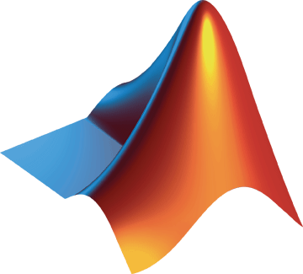
Agenda
Introduction to MATLAB
Demo: Fuel economy analysis
Importing data
Creating visualizations
Curve fitting
Creating an app
Resources to get started
Grab your goodies and doughnuts!

Slide 4



Jack Little
December 7,1984
Natick, Massachusetts, USA
Cleve Moler
Steve Bangert
To provide an environment for scientists, engineers and programmers to analyze and visualize data and develop algorithms, and Simulink, a graphical and simulation environment for model-based design of dynamic systems.
Notes:
The company's key product, MATLAB, was created in the 1970s by Cleve Moler, who was chairman of the computer science department at the University of New Mexico at the time. He was the company's chief scientist and chairman. Jack Little, who would eventually set up the company, came across the tool while he was a graduate student in electrical engineering at Stanford University. Jack Little took the titles of president and CEO and was at first the only employee. MathWorks had been formed to commercialize a technical computer programming language and interactive environment Moler had originally created in Fortan for mainframe computers in the late 1970s. Called Mat-Lab, a personal computer (PC) version was translated into C several years later by Little and another engineering consultant, Steve Bangert.

Slide 5

MATLAB
MATrix LABoratory
MATLAB was designed to compute large arrays of data in matrixes.
It was faster than older programming languages such as Fortran at processing large amounts of data.
Integrated Development Environment
Data Analysis and Visualization
Algorithm/Controller Development
Create model, Numeric Computation, Modeling & Simulation
Software Application with 100+ Toolboxes
Supporting Packages, & Add-Ons

Slide 6
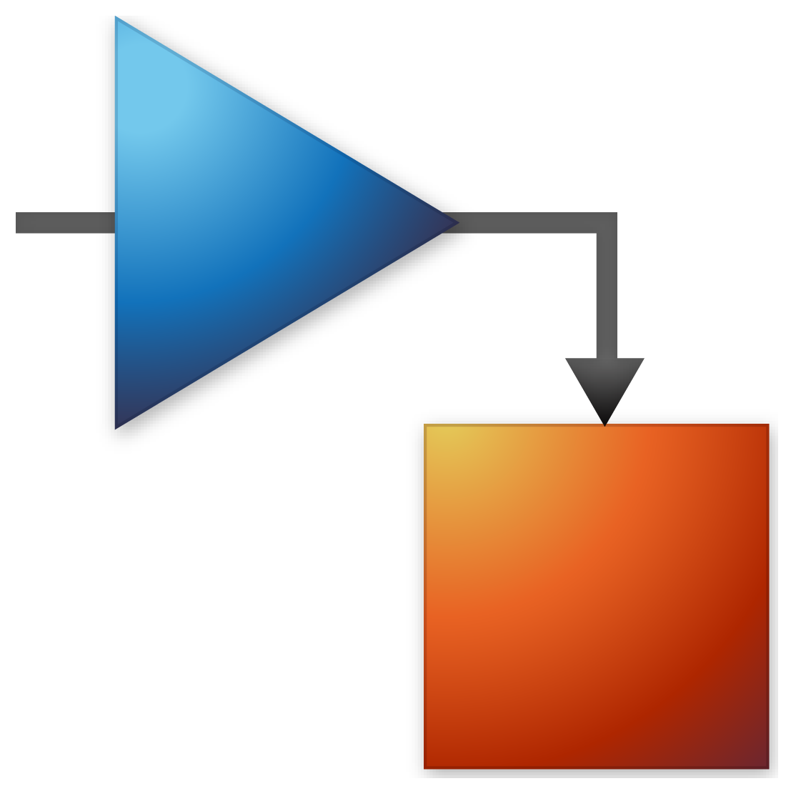
SIMULINK
Platform for Model-Based Design that supports system-level design, simulation, automatic code generation, and continuous test and verification of embedded systems.
Primary interface is a graphical block diagramming tool and a customizable set of block libraries.
Widely used in automatic control and digital signal processing for multidomain simulation and model-based design.

Slide 7
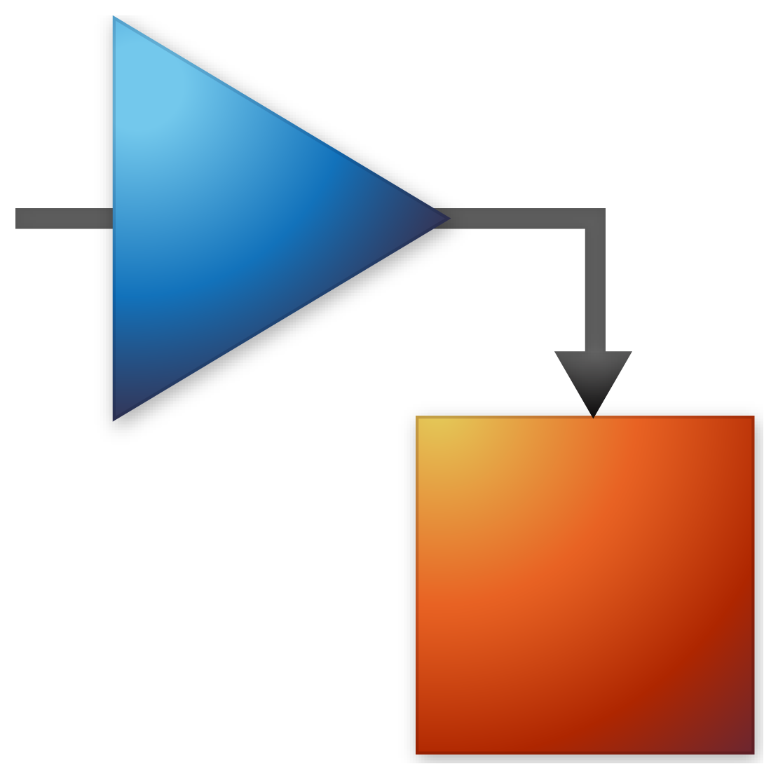
MATLAB vs SIMULINK
The Simulink approach is based on time based and multi rate system, so that will be useful for HDL (Hardware Description Language) code generation. Simulink is graphical and more interactive to the user.
MATLAB is for the mathematics based algorithm development and which will not consider the time while in simulation (independent of time).
Notes:
A multirate DSP system uses multiple sampling rates within the system. Whenever a signal at one rate has to be used by a system that expects a different rate, the rate has to be increased or decreased, and some processing is required to do so.

Slide 8
WHY MATLAB?

Slide 9
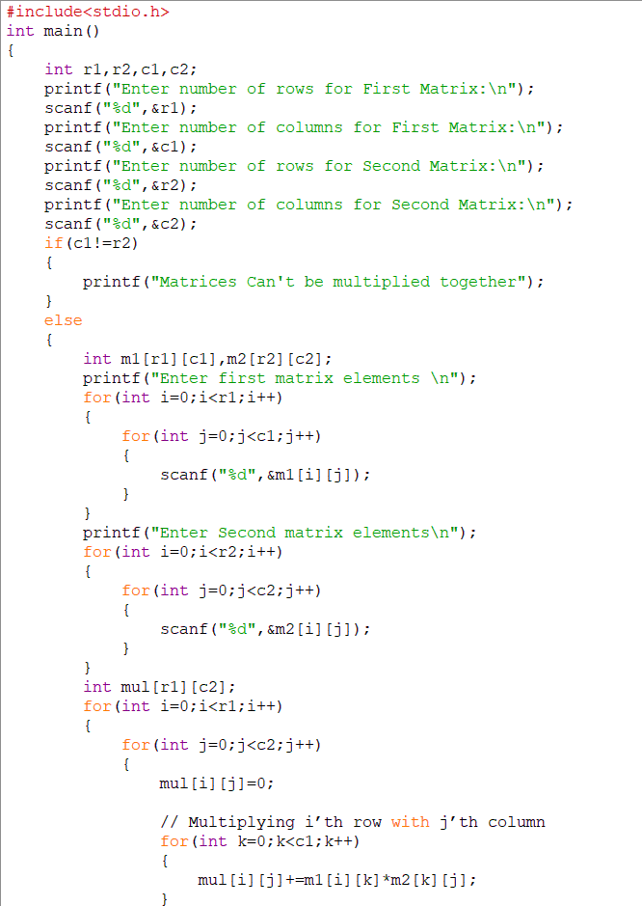

Traditional C code for multiplying 2 Matrix

Slide 10

MATLAB code for multiplying 2 Matrices
A = [1 2 3; 2 3 4; 4 5 6];
B = [1 2 3; 4 5 6; 7 8 9];
C = A*B

Slide 11




Why we need Matlab ?
Design
Use Model-Based Design with MATLAB to shorten development cycles and reduce your develop time by 50% or more.
Accuracy
By default, MATLAB uses 16 digits of precision.
Optimization
You can solve data intensive problems by using parallel computing to explicitly access all of your hardware resources.
Speed
3x faster than Python
Notes:
In computing, half precision (sometimes called FP16) is a binary floating-point computer number format that occupies 16 bits (two bytes in modern computers) in computer memory. It is intended for storage of floating-point values in applications where higher precision is not essential, in particular image processing and neural networks.

Slide 12




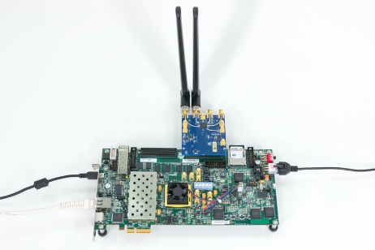




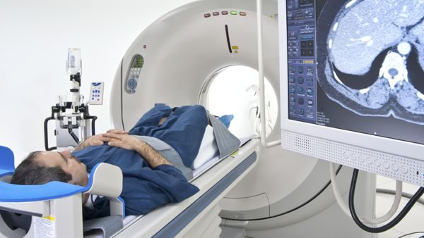
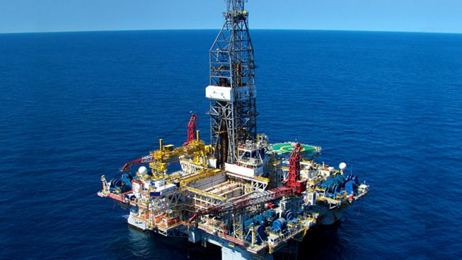
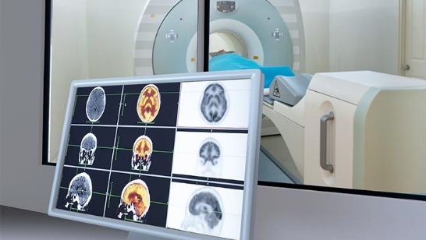
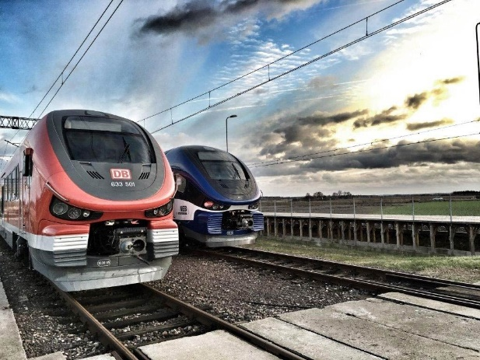

Key Industries that use MATLAB
Aerospace and Defense | Automotive | Biological Sciences | Biotech and Pharmaceutical | Communications
Electronics | Energy Production | Financial Services | Industrial Machinery | Medical Devices
Metals, Materials, Mining | Neuroscience | Railway Systems | Semiconductors | Software and Internet
Notes:
In total, MATLAB is used in over 20 industries, from aerospace and automotive, to biotech, energy production, financial services, medical devices, and railway systems.
What about the companies that use MATLAB? Let’s take a look at some of the key companies that use MATLAB and see if you recognize any.

Slide 13




A few companies that use MATLAB
4 million+
users in 185 countries
Amazon
Apple
AT4 wireless
BAE Systems
Bank of England/PRA
BMW
Boeing
Facebook
Ford Motor Company
Genentech
Google
Huawei
Hydro-Québec
Intel
Johnson & Johnson
JP Morgan
NASA
Nokia
Qualcomm
Samsung
Siemens
Tetra Pak
Texas Instruments
Toyota
“If you want to work at Google, make sure you can use MATLAB”
Jonathan Rosenburg,
former Google Senior Vice President
Business Insider 2014
100,000+
businesses, governments, and universities
All of the top 10 automotive and aerospace companies
OICA: 2017 World Motor Vehicle Production PwC: Aerospace and Defense 2018 Year in Review
Notes:
Millions of engineers and scientists worldwide use MATLAB and Simulink. In fact, there are over 4 million users of our products in 185 countries
Our software is used at over 100,000 businesses, governments, and universities around the world
And all of the top automotive and aerospace companies use our products
Knowing MATLAB is a game changer when looking for a job as former SVP of Google will tell you.
Now that we know what MATLAB is for and where it’s used let’s take a look at how people are using MATLAB to advance the world.

Slide 14

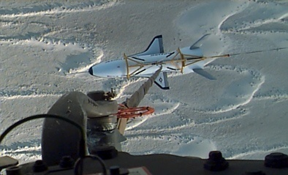
MATLAB and Simulink Help Land Unpiloted Boeing Spacecraft
Challenge
Design a guidance, navigation, and control (GN&C) system that allows the X-40A to land and come to a full stop on a standard runway without either power or a pilot
Solution
Use MathWorks tools to streamline software implementation, shorten the design-to-software-to-verification cycle, and enable them to make late changes
Results
Rapid development within budget
A successful test flight
A contract to continue development
Boeing X-40A – in test flight (directly above) and on the ground (top).
"I am very pleased with the results of this flight test. It is a significant step in the development phase."
- John Fuller, Boeing
Link to article

Slide 15
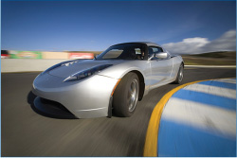
Using Model-Based Design to Build the Tesla Roadster
Challenge
Develop a 100-percent electric production sports car on a limited budget
Solution
Use MathWorks tools for Model-Based Design to model and simulate the vehicle, analyze performance, and evaluate design trade-offs
Results
Calibrated system model, improving simulation accuracy
Hundreds of powertrain configurations tested without using physical prototypes
Multidomain effects simulated, enabling dramatic advances in battery technology
The Tesla Roadster.
“We couldn’t have built this car without MathWorks tools. It would have taken resources that our new automotive startup company simply did not have. We will continue to rely on MATLAB and Simulink to help us make informed design decisions for the next generation of Tesla vehicles.”
Dr. Chris Gadda and Dr. Andrew Simpson, Tesla Motors
Link to article

Slide 16

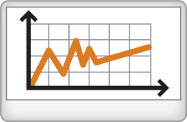




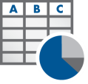


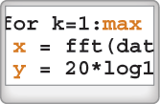


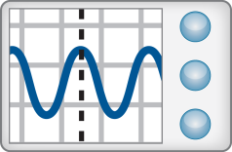
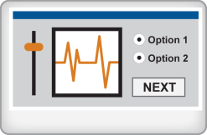
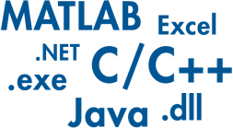
Technical Computing Workflow
Access
Explore & Discover
Share
Files
Reporting and Documentation
Data Analysis & Modeling
Software
Algorithm Development
Outputs for Design
Code & Applications
Application Development
Hardware
Deployment
Automate
Notes:
To solve one of the problems we just saw engineers use the technical computing workflow. In this workflow people:
Access: data or information whether it be from data files, other software, or directly from sensors and hardware.
Explore and Discover: various results with the data using equations, algorithms or functions. This step could involve visualization, machine learning or optimization depending on the application.
Share: your results or findings to others through code, reports or as design specifications.
This process is a repetitive cycle regardless of the application. But with MATLAB the workflow can be automated to save time and errors.

Slide 17
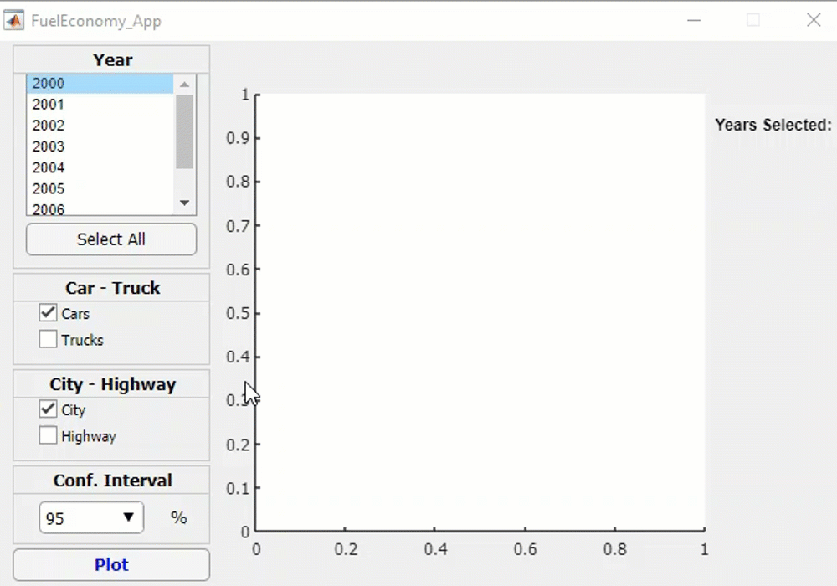
Demo: Fuel Economy Analysis
Goal:
Study the relationships between fuel economy, horsepower, and type of vehicle
Approach:
Access data from Excel
Interactively visualize and explore trends
Create a model
Document results
Notes:
This is where you switch over to MATLAB to do the demo.

Slide 18

Demo Summary Fuel Economy Analysis
Products Used
MATLAB
Statistics and Machine Learning Toolbox
Curve Fitting Toolbox
MATLAB Compiler
Access
Explore & Discover
Share
Files
Reporting and Documentation
Data Analysis & Modeling
Software
Algorithm Development
Outputs for Design
Code & Applications
Application Development
Hardware
Deployment
Automate
Notes:
This demo is just one example of the technical workflow. In this demo we
Access: Accessed data from excel files
Explore and Discover: We explored some visualization options using the plot tabs. Used the curve fitting tool to explore different fits that could apply to the data. We also showed how we can use functions and apps to further analyze the data
Share: We learned how we can export scripts as reports and share apps as a standalone executable.
With all the tools that MATLAB offers there’s many other ways to tackle this workflow. Let’s take a look at other ways you can use MATLAB to tackle the problems you need to solve.

Slide 19

Demo Files
Email: tcd.matlab@gmail.com

Slide 20
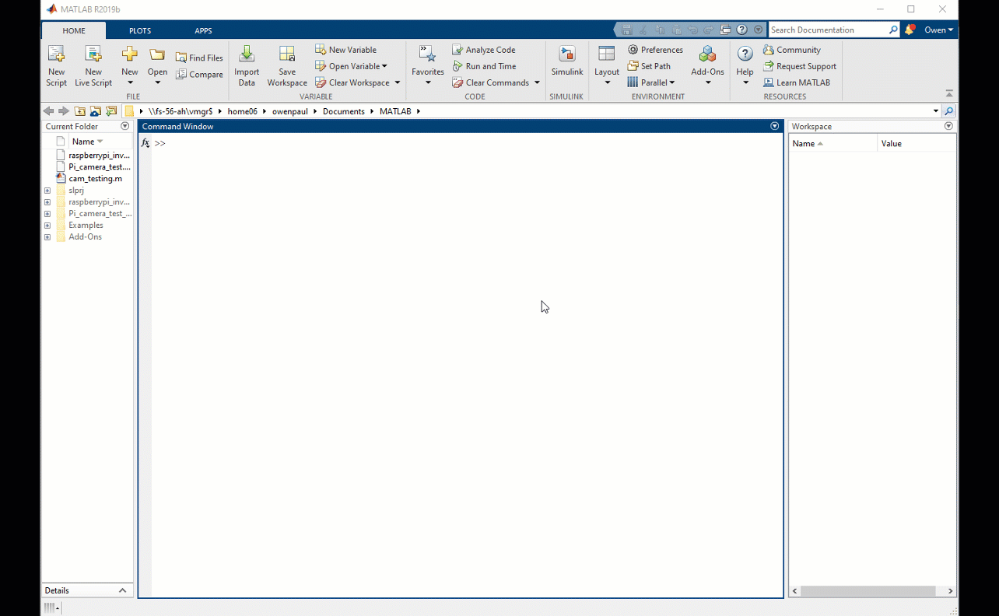
Get Started Today: MATLAB Onramp
2 hours of introductory material
Free access
Self paced, progress saved
Other onramps available
Machine Learning
Deep Learning
Simulink
Stateflow
Notes:
MATLAB Onramp is for new users, students or people who want to explore the MATLAB environment or evaluate its capabilities. MATLAB Onramp is a free course that offers a strong foundation for future learning by delivering basic MATLAB skills and ensuring users are comfortable navigating the MATLAB environment.

Slide 21











Additional Self-Paced Training Courses
These courses are free with your university MATLAB license
Computational Mathematics
Solving Nonlinear Equations with MATLAB
Solving Ordinary Differential Equations with MATLAB
Introduction to Linear Algebra with MATLAB
Introduction to Statistical Methods with MATLAB
Introduction to Symbolic Math with MATLAB
9 hours of short courses on computational mathematics topics
Core MATLAB
Data Science
MATLAB Fundamentals
MATLAB Programming Techniques
MATLAB for Financial Applications
MATLAB for Data Processing and Visualization
Machine Learning with MATLAB
Deep Learning with MATLAB
Over 80 hours of comprehensive MATLAB learning content
Notes:
Only show this slide if your school offers MAOTS. If you’re unsure whether your school has a MAOTs license reach out to your MathWorks Technical Point of Contact.

Slide 22
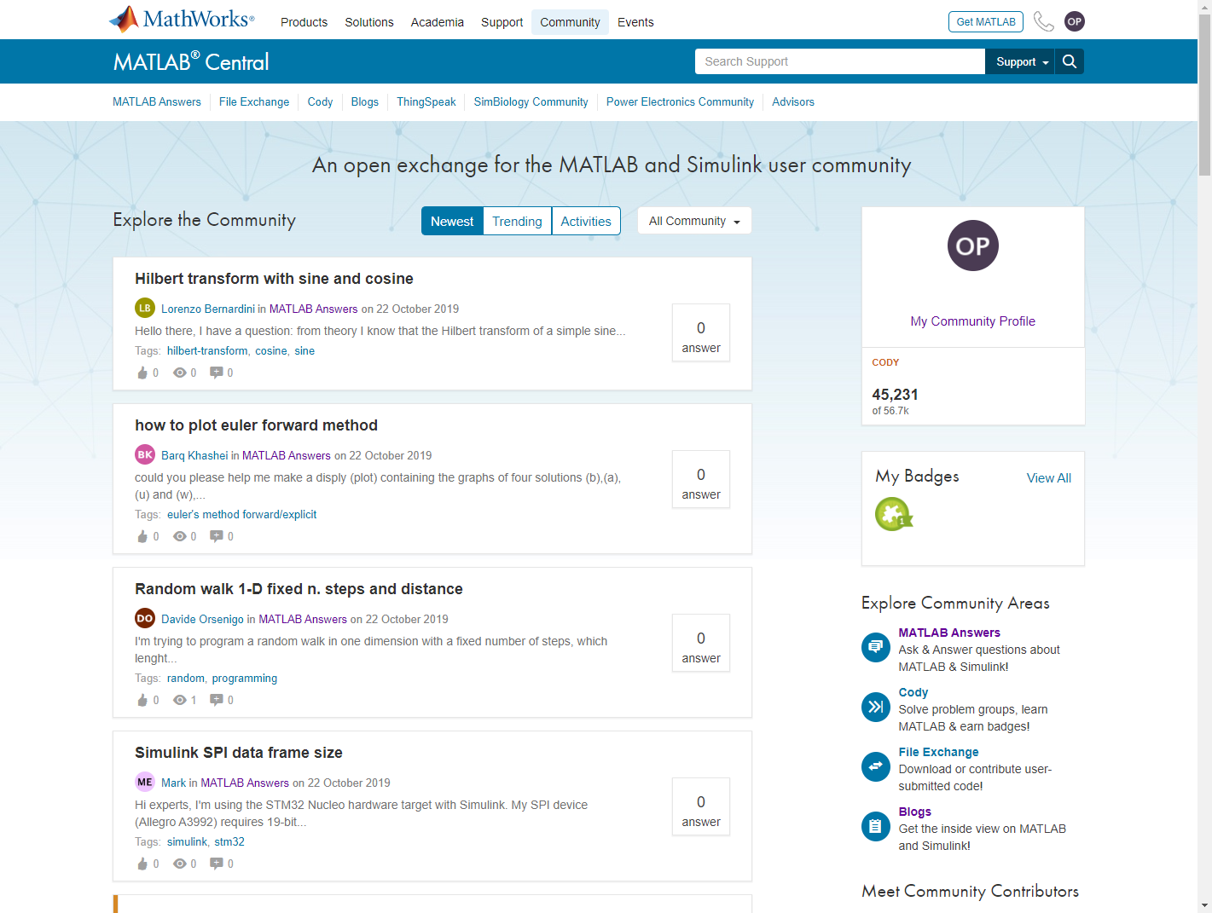
MATLAB Central
Community for MATLAB and Simulink users
Over 70k daily visits
File Exchange
Access more than 10k free files including functions, apps, examples, and models
MATLAB Answers
Ask or search programming questions
18k+ community-answered Questions
Blogs
Read commentary from engineers who design, build, and support MATLAB and Simulink
Notes:
MATLAB Central is a gathering place for the MATLAB and Simulink community. Members in this community find answers to their technical questions, get code, practice their programming skills, and stay up to date on ways engineers and scientists around the world use MATLAB® and Simulink® to do their work.
If you have a question about MATLAB whether you’re stuck or just wondering what you can create with it MATLAB central is the first place to go.

Slide 23
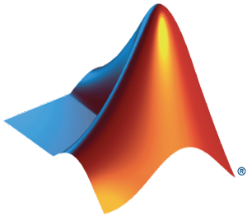
Additional resources
MATLAB and Simulink Tutorials
Self paced courses
Videos and webinars
Getting started with MATLAB Videos
App Designer
MATLAB Plot Gallery

Slide 24



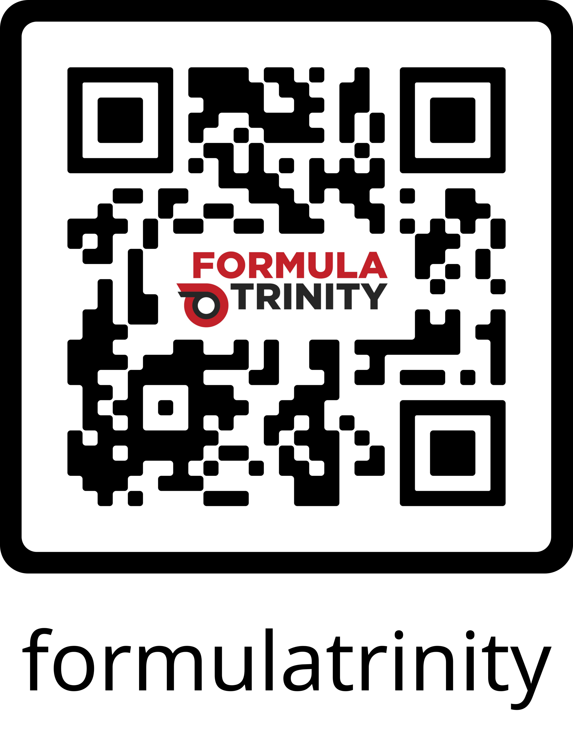
Follow us for upcoming events!
Feedback form

